Slide 1
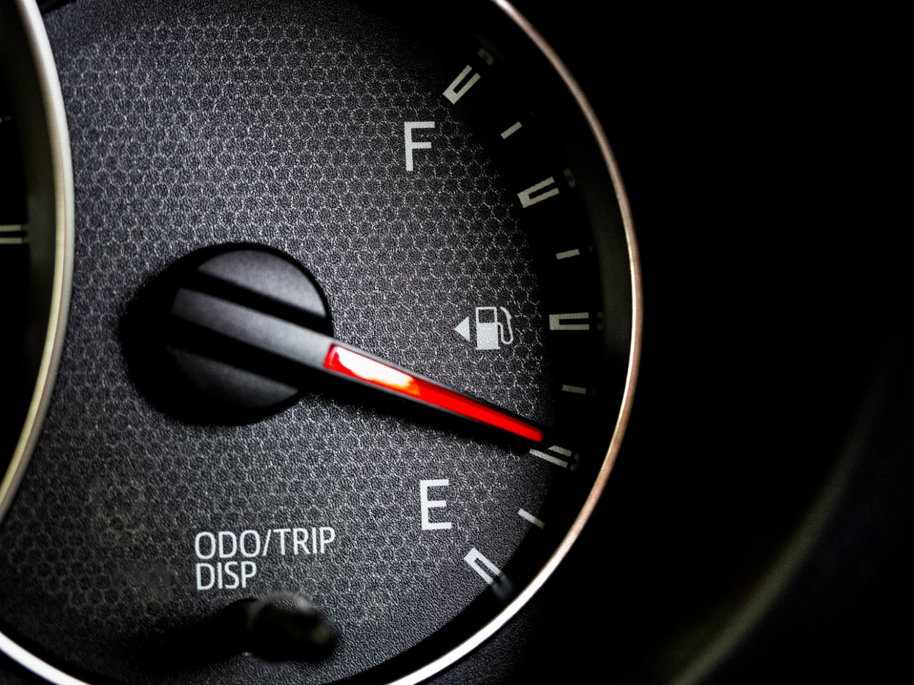
Week 10 Key Deliverables
SkyLedge Predictive Maintenance Project

Slide 2
Driver Behavior

Slide 3

What?

Slide 4
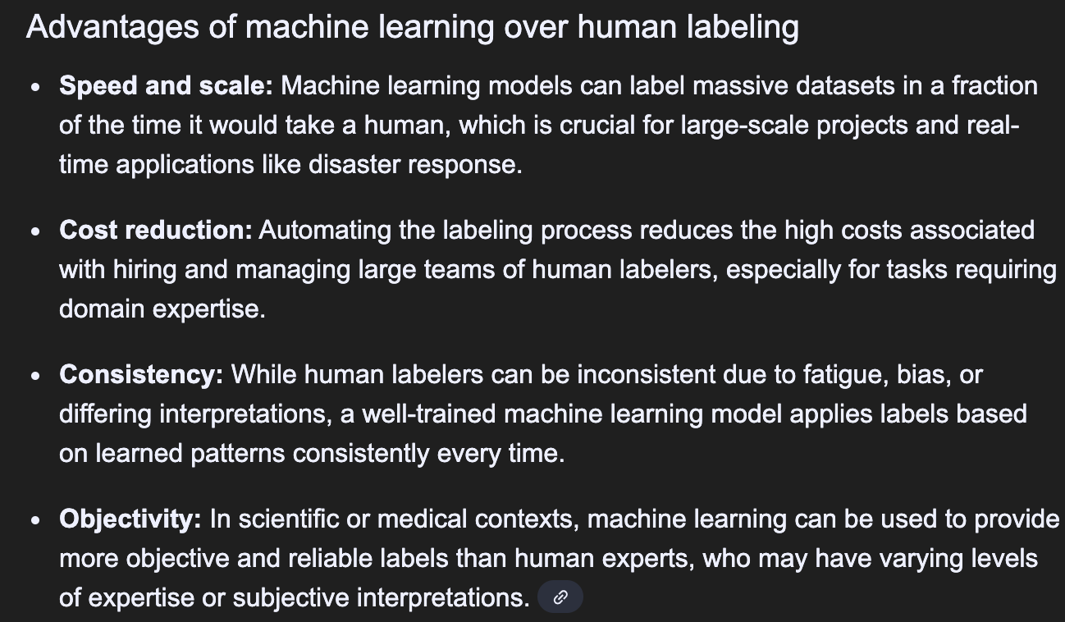
Why?

Slide 5
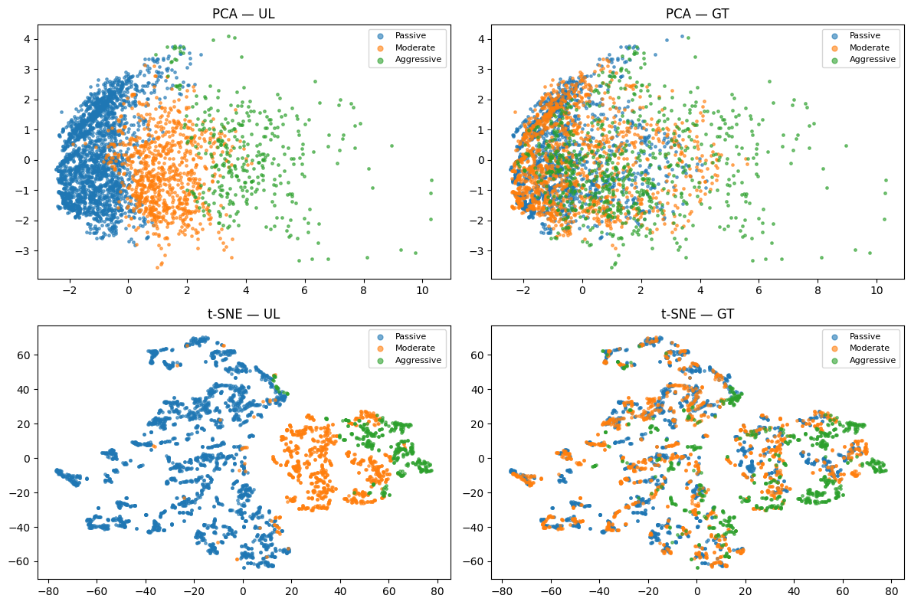
How?

Slide 6
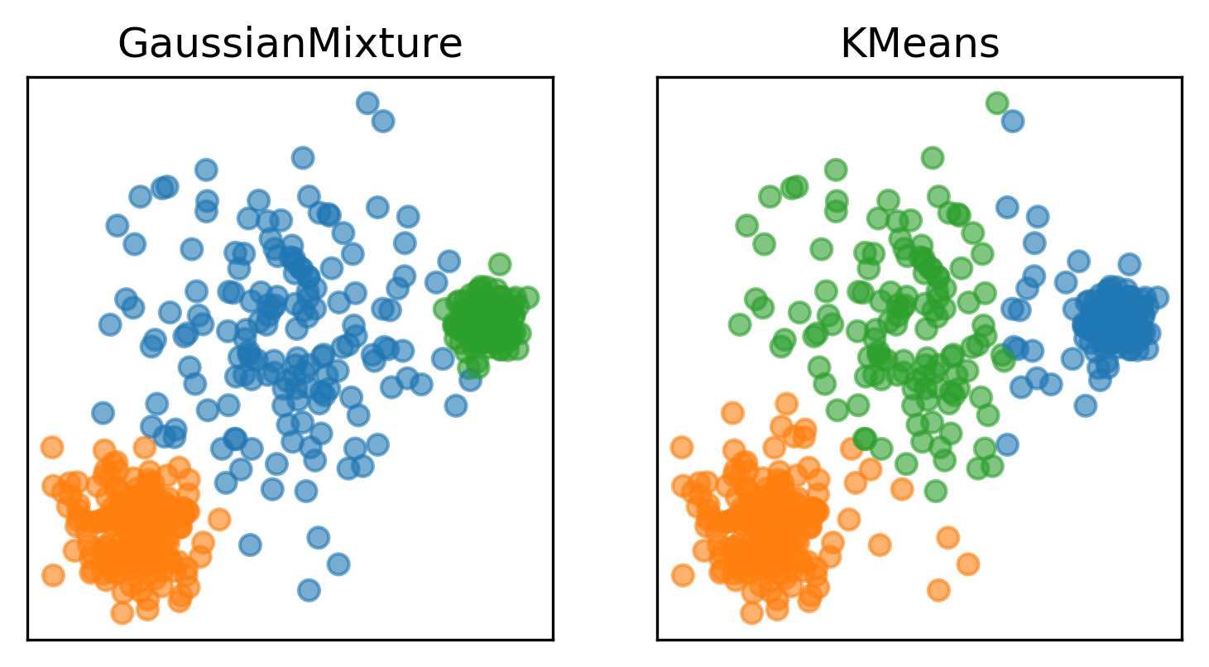
Why?

Slide 7
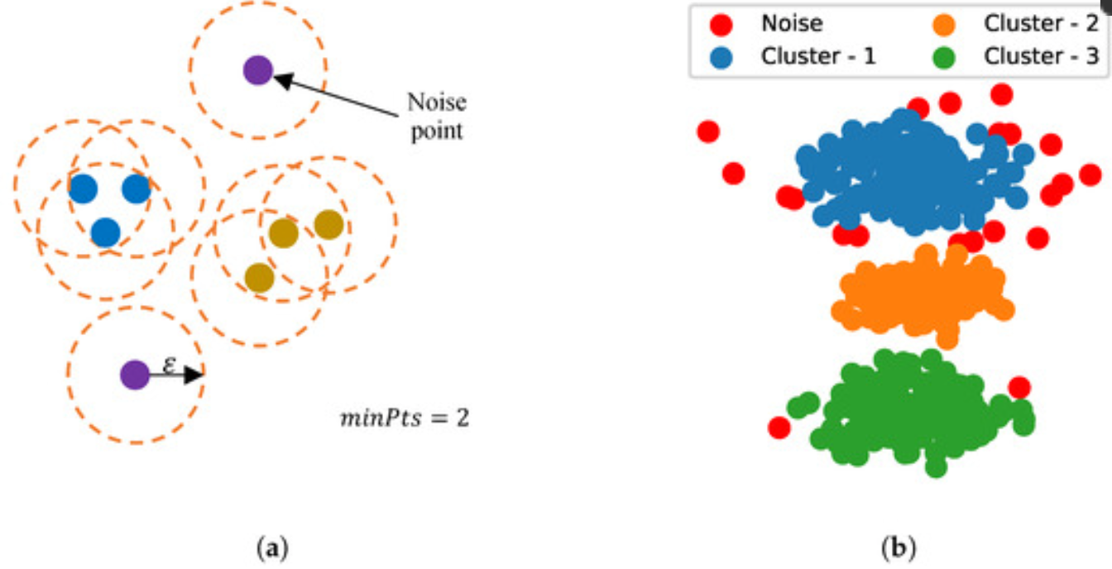
What?
Using Bayes' Theorem to calculate the posterior probability of a data point belonging to a specific component. The mathematical algorithm typically used is an extension of the Expectation-Maximization (EM) algorithm, or more advanced methods like Variational Inference or Markov Chain Monte Carlo (MCMC) sampling, to iteratively estimate the model's parameters, including the mixture weights, means, and covariances.
Notebook URL: https://colab.research.google.com/drive/1FjFtb5qFgPciVY57ylKZaqwjEEfKkIQH

Slide 8
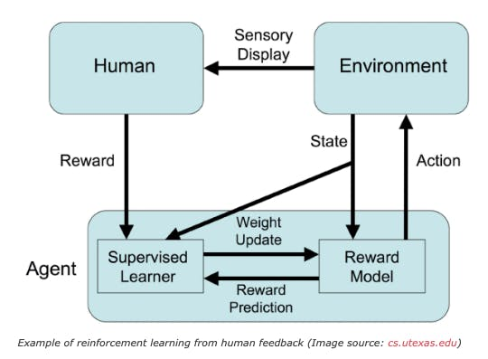
How?

Slide 9
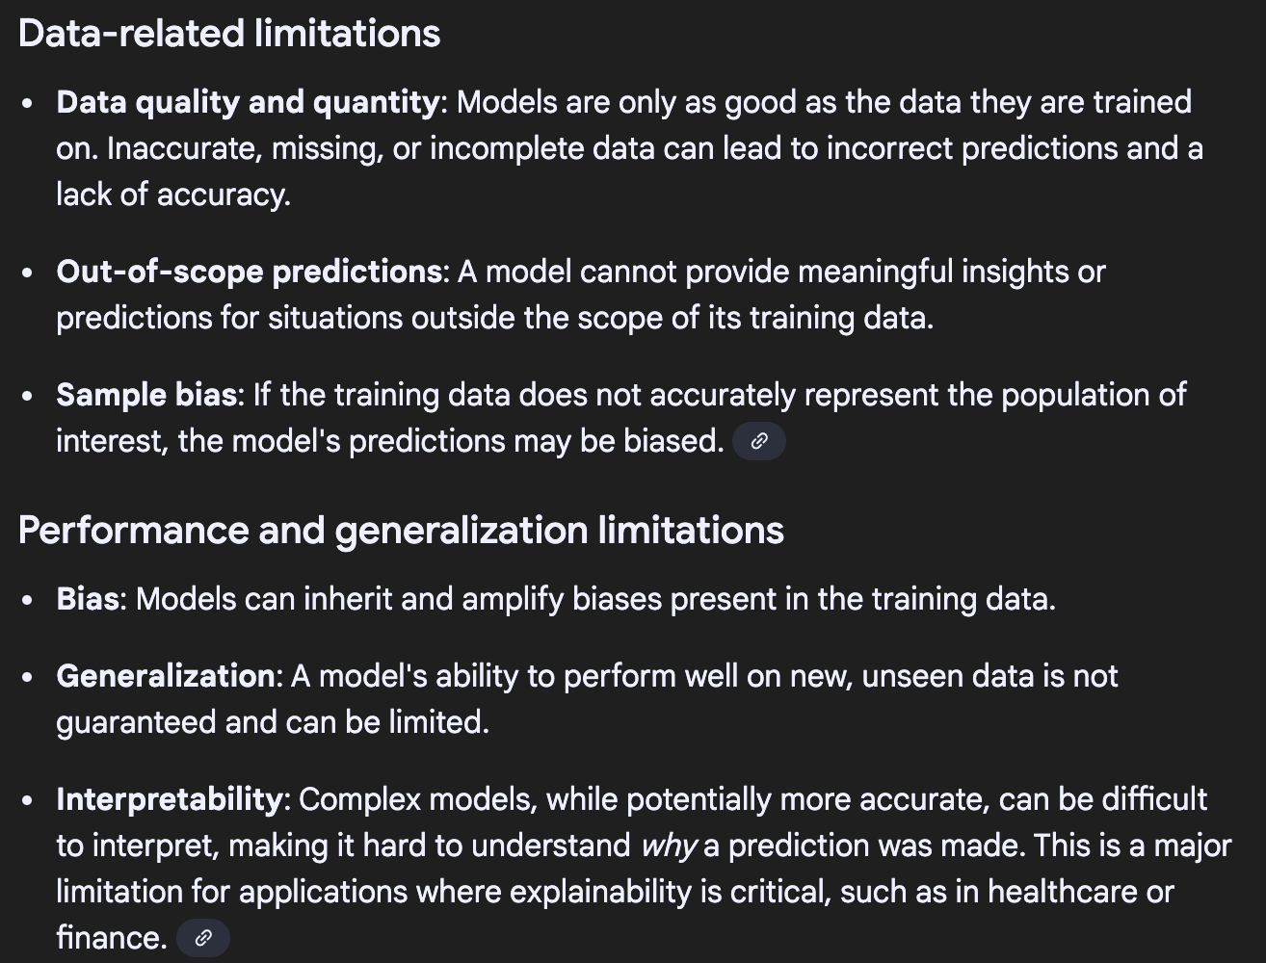
Constraints

Slide 10
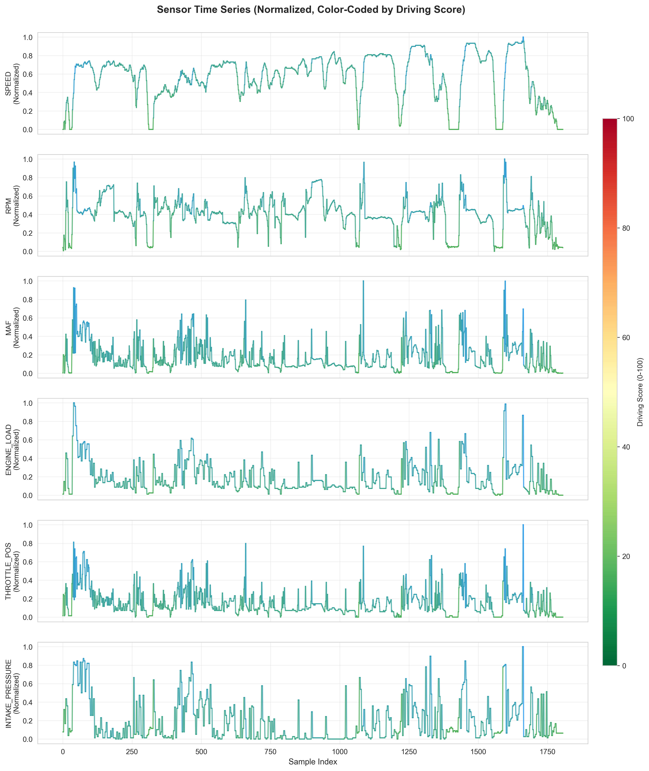
Algorithmic approach to driving scoring
Min max values to determine efficiency score based on sliding scale. Working on approach to dynamically adjust min max values based on new data

Slide 11
Cost Efficiency

Slide 12
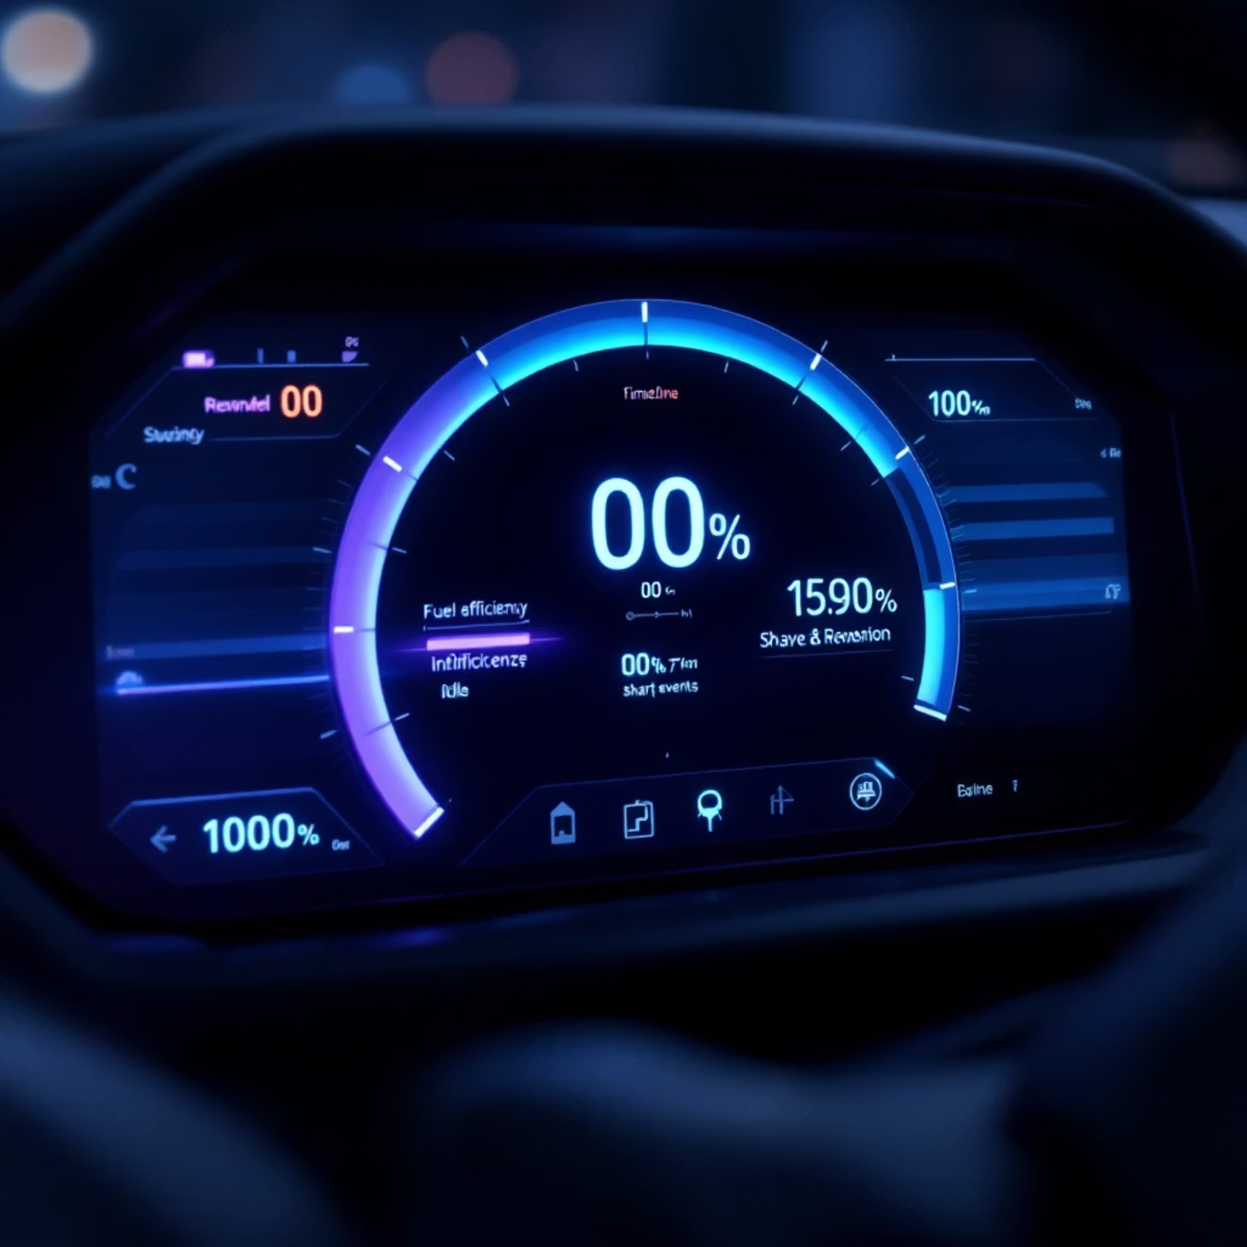
Ideology
From supervises, incl featured engineering (best features), such efficiency scoring can be derived with threshold rules + ML/UL.
Magnitude of the spike (least prior)
Frequency of the spikes
Duration of the spikes
High duration of Idle
*Where spikes = constant acce/deccelerations.
Notebook URL: https://colab.research.google.com/drive/1zy1FSJwN2MAYFWe32F71B1ABHfdfJEmE

Slide 13
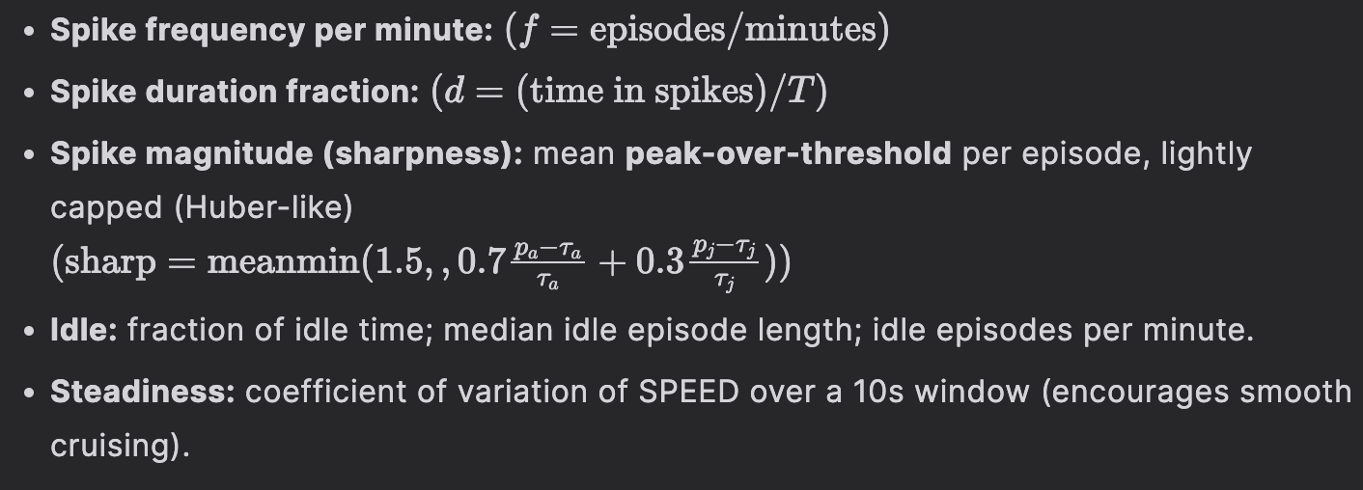
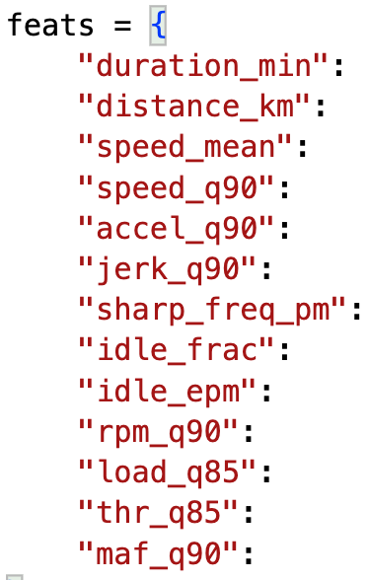
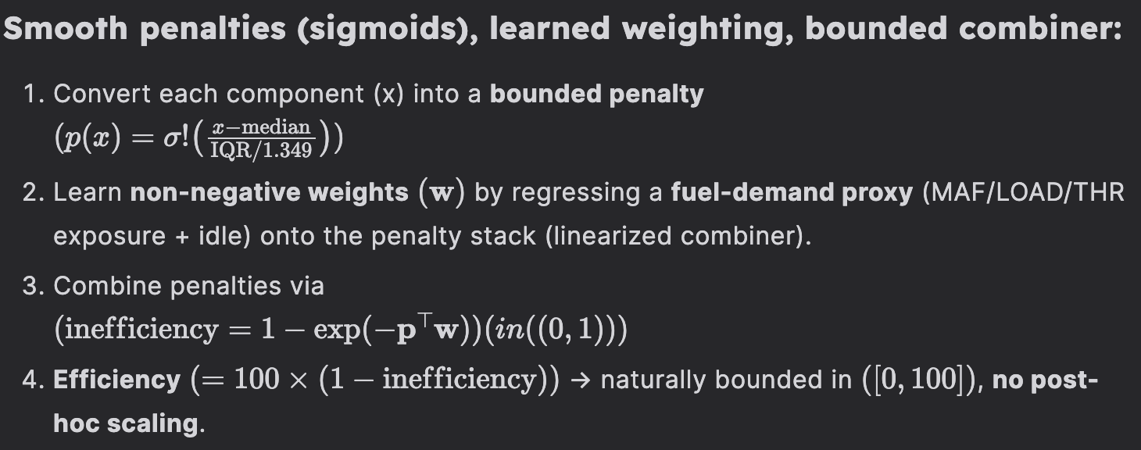
Methodologies
<<
Train & Export
^
^
Weights algorithms
v
v
HistGradientBoostingRegressor
IsotonicRegression
HistGradientBoostingRegressor
Feature selections
<<
ML smoother​
Penalty algorithms ​

Slide 14
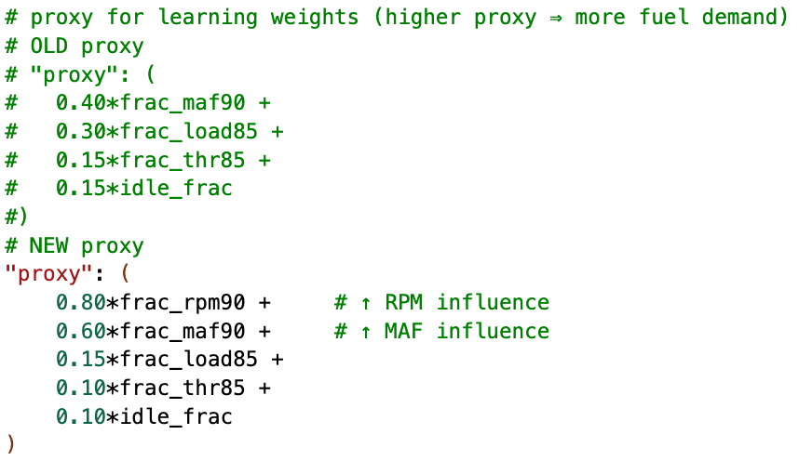
Adjustments

Slide 15
Packaging
Teacher: build a physics-aware “teacher” (hybrid)
Reads sharp acceleration/braking, idle exposure, RPM/MAF high-load time, and speed steadiness.
Converts these into smooth penalty curves → combines with learned weights vs the new proxy.
Outputs a 0–100 efficiency score, stable across short and long routes.
v​
v
Student: “teacher → student” training
Features: duration, distance, speed CV, idle %, sharp-event rate, RPM/MAF p90, and proxy (RPM90×MAF90).
Model: monotonic gradient-boosting + isotonic calibration for reliable scaling.
Handles any trip length via windowed scoring + distance weighting. Results after calibration:
Raw: R² = −0.10 → mis-oriented
After orientation fix (invert = True): R² = 0.625, Pearson 0.79, Spearman 0.82
Model: https://huggingface.co/BinKhoaLe1812/Fuel_Efficiency_OBD

Slide 16
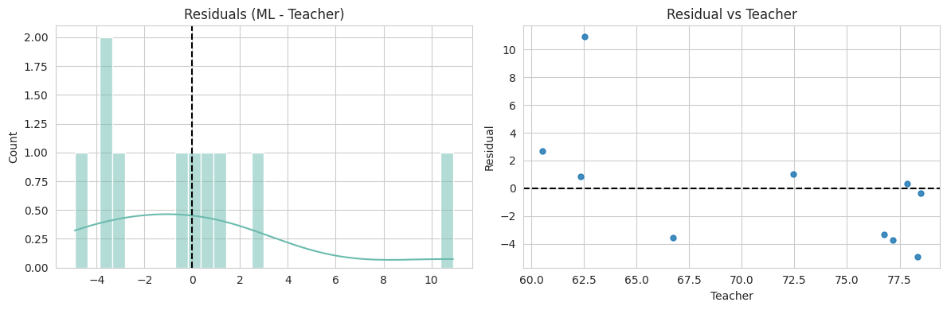
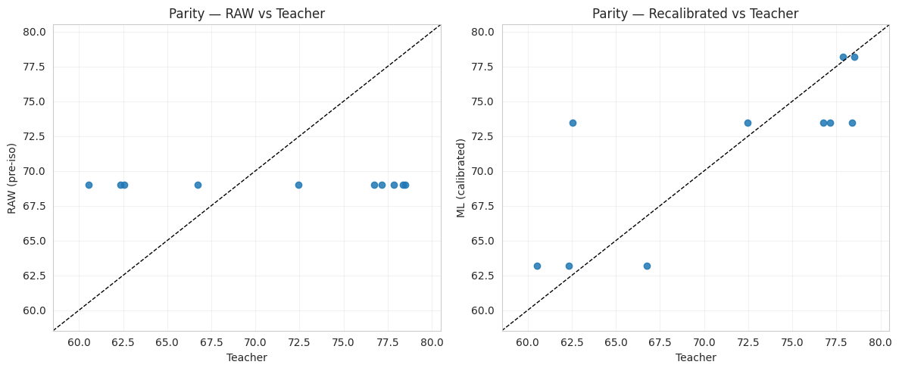
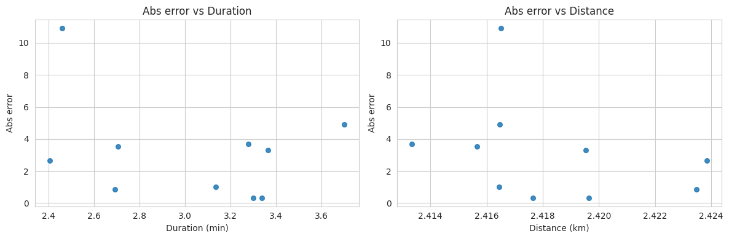
Outcome
=== RAW ensemble outputs vs Teacher ===
MAE : 7.09 | RMSE: 7.47 | R^2: -0.105 Pearson r : nan | Spearman : nan
=== Calibrated (stored orientation=False) vs Teacher ===
MAE : 6.99 | RMSE: 7.32 | R^2: -0.063 Pearson r : nan | Spearman : nan
=== Calibrated (re-fitted; invert=True) vs Teacher ===
MAE : 3.15 | RMSE: 4.35 | R^2: 0.625 Pearson r : 0.790 | Spearman :

Slide 17
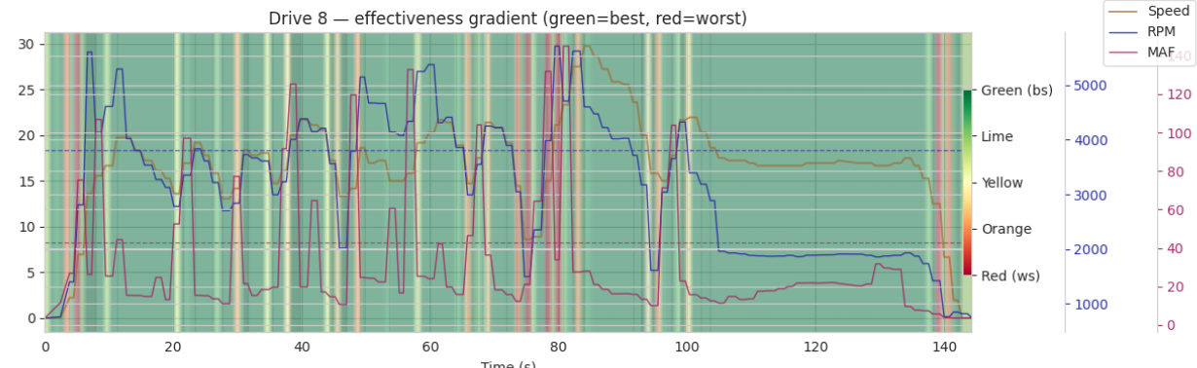
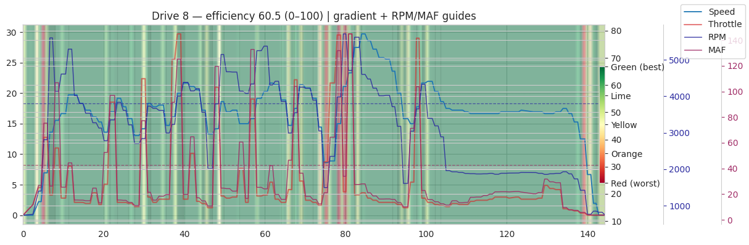
Outcome

Slide 18
Frontend and Interactive Dashboard

